Slide 1

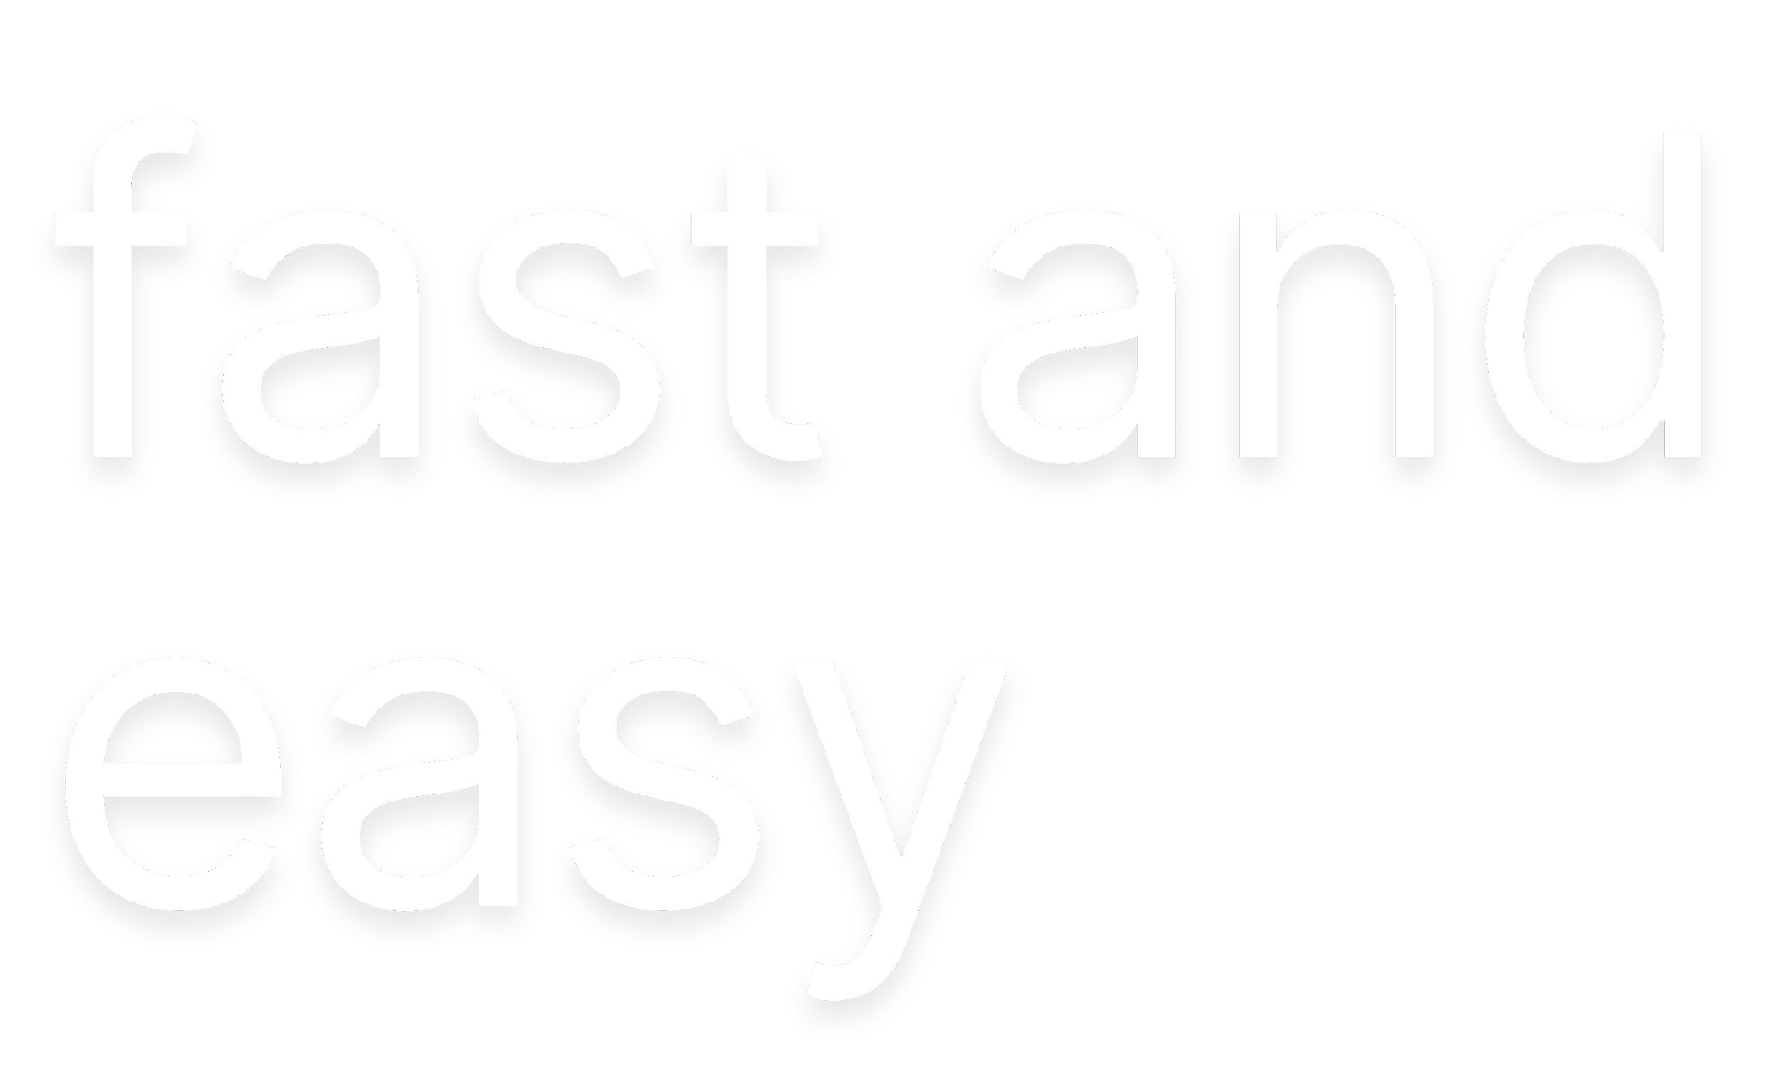




Aidana Assylkhan
Aleksandra Korobeinikova
Ekaterina Bozachidi

Slide 2
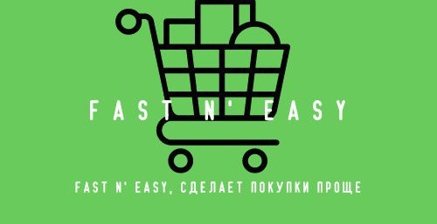

Slide 3
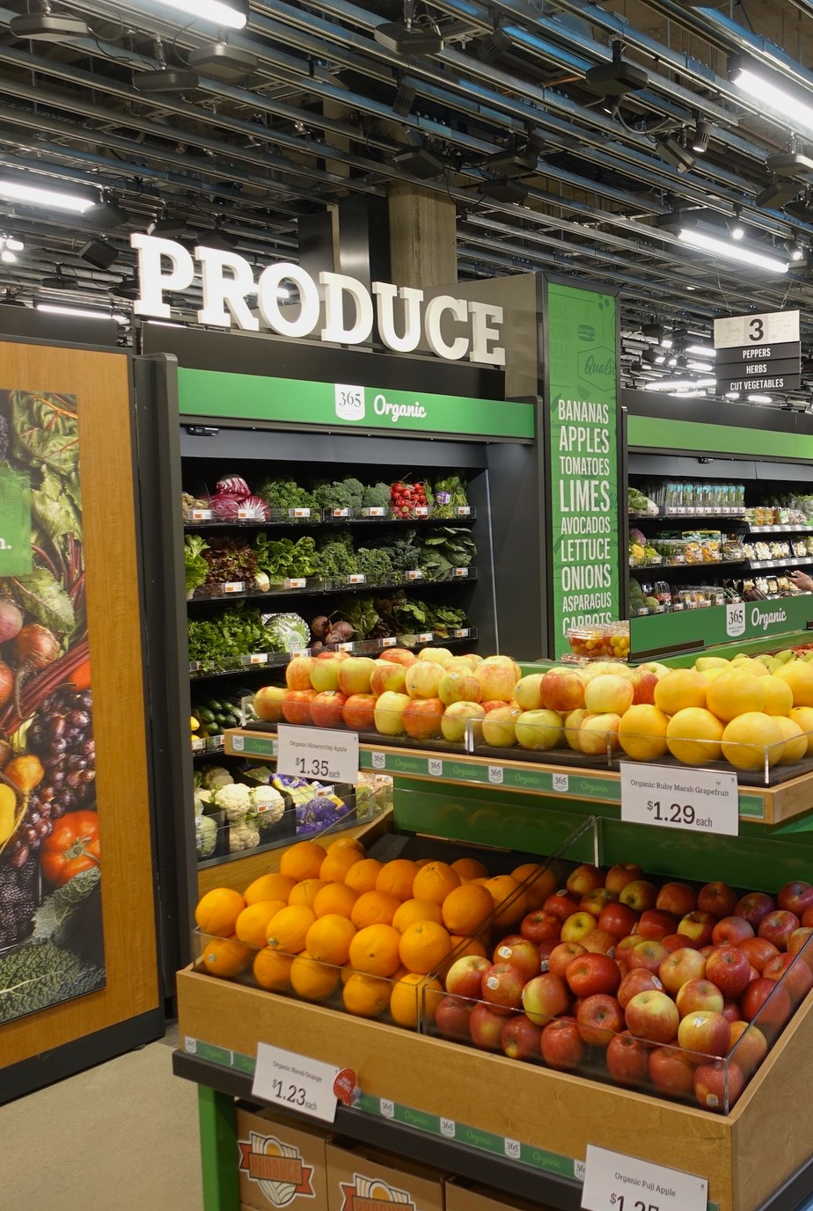


The main problems that our project solves are lack of time, standing in queues, problems with thefts in the markets and the like. A smart market or a market without cashiers. the project solves our everyday problems and makes our life easier.
I just went into the store, took the right product and left. It's simple.
Cameras, sensors that recognize a person and his actions. This project has existed in the USA since 2016. And it already exists in several states of America. This indicates that the store is in demand among people.

Slide 4

Target Audience
THIS BUSINESS IDEA WILL WORK, SINCE IT ALREADY IS IN SOME STORES ABROAD TODAY, SUCH A STORE IS NECESSARY FOR PRACTICALLY EVERYONE. WE ALL HAVE A VERY LONG LIST OF TASKS TO COMPLETE IN THE DAY, SO EVERY MINUTE IS IMPORTANT. WITH THE HELP OF OUR STORE PEOPLE SAVE THEIR TIME AND WILL NOT THINK ABOUT PAYING FOR GOODS, SINCE EVERYTHING WILL IMMEDIATELY BE CHARGED FROM THE CARD, WILL NOT STAND IN LINES AND WASTE TIME ON SCAN OF EACH GOODS. OUR MOTTO "QUICK AND SIMPLE", AND WE FULLY OBSERVE IT.

Slide 5


Fast N’ Easy is created because there exists customer needs for convenient grocery shopping. By providing a premier customer experience via fast delivery, superior customer service and access to a wide range of products at a lower cost, out company gains a huge customer experience. Also, company is offering a digitally integrated grocery shopping experience that is efficient and saves customers their time like no other.In this case, there are no similar stores in Kazakhstan with which we could compete.

Slide 6

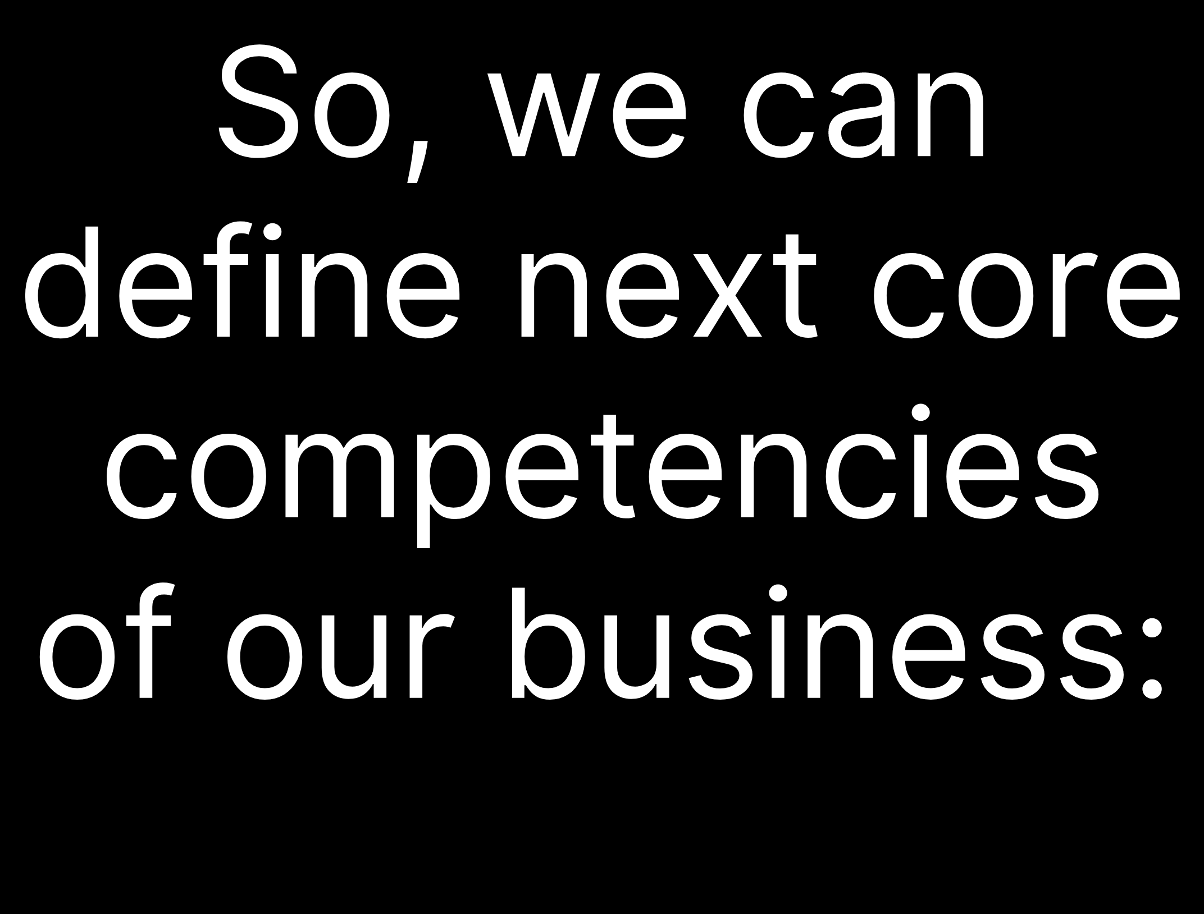
We are associated with the latest stores, everything is very fast, come, take everything you need, and do not think about paying, everything is already thought out Advantages:
- speed, people do not stand at the checkout, they just go through the scanner and the money is debited from their accounts,
- security, thieves will not be able to pass, as the scanner will immediately give them out, they will have nowhere to hide the goods.
- everything is very easy and simple, you do not need to carry cards, money with you, your funds just need to be in the account, the rest is up to the debit program.
Our strategy is to provide the widest selection possible and achieve customer satisfaction in the most operationally effective way.

Slide 7
Advantages:
- Prices like in supermarkets
- Delivery and quantity
Own vegetable (fresh vegetables every day)
Fewer employees and marriages
Barriers to implementation:
Mentality
Innovation
Difficulty of entry
Distrust of the system
Hacking opportunities

Slide 8
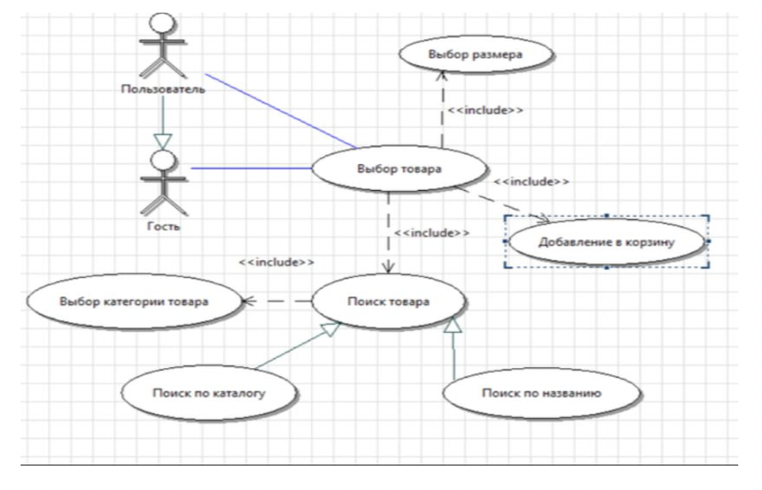
UML Diagram

Slide 9
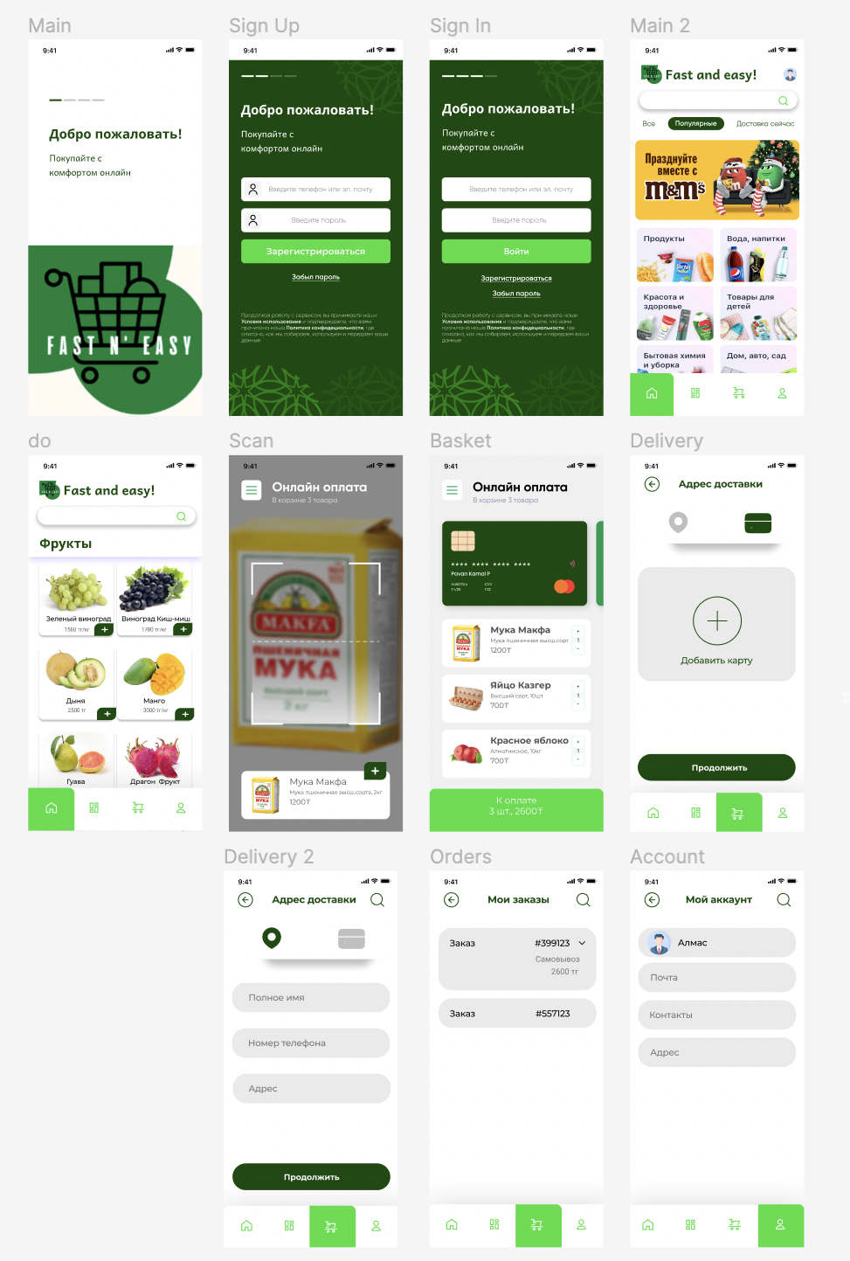
Mock - up
https://www.figma.com/file/0fIQAmxJrDqlve7bPS1IPo/Untitled?node-id=0%3A1&t=zv6UJbH6uprvjy9B-0

Slide 10
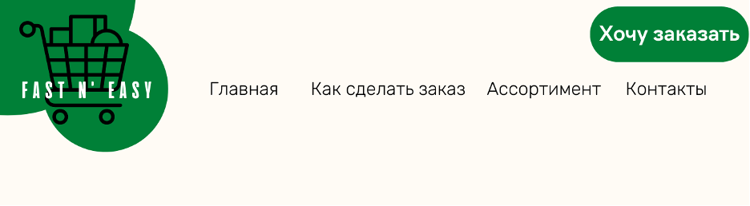
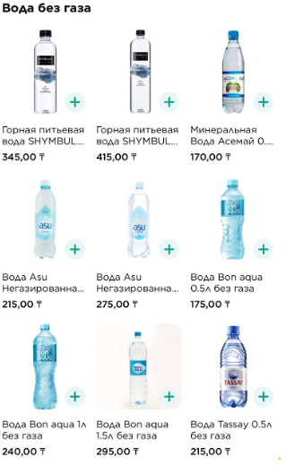
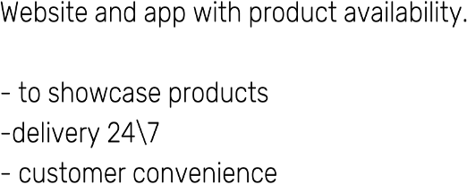

Slide 11
Participants in information system and their roles.
• traffic marketer
• web analyst
• customer service manager
• business analyst
• Content manager
• Web Designer
• online merchandiser
• email marketer
• site administrator
• online platform manager
• Product manager
• Project Manager
• strategic planning manager
• financial analyst
• manager of logisticks
• operations manager
• internet marketer

Slide 12
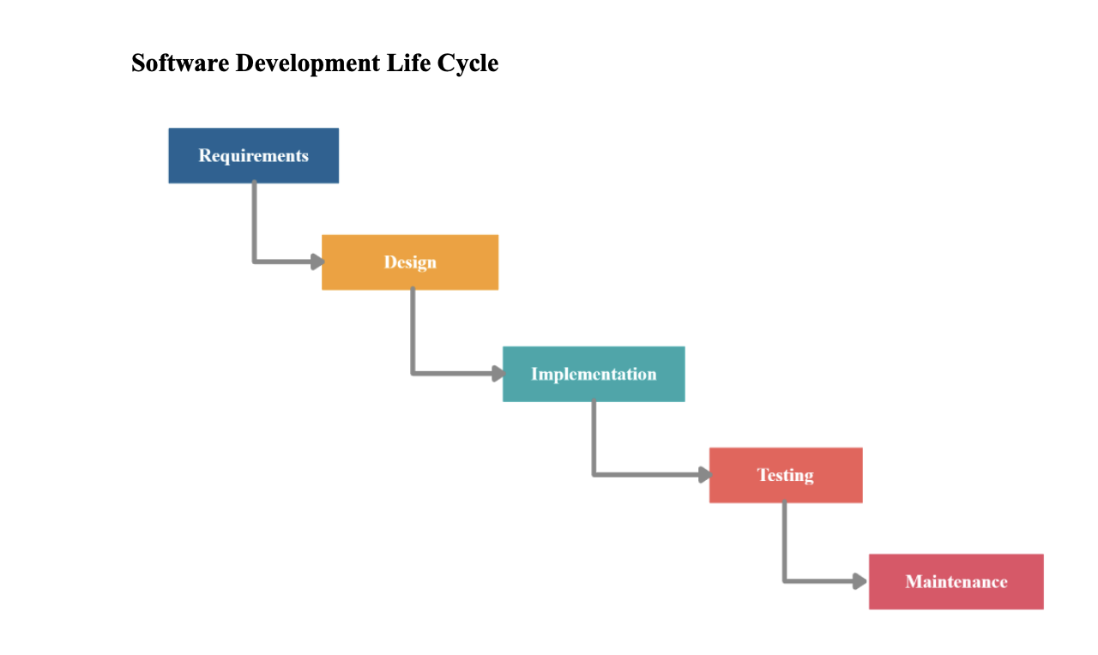
Software Development Lifecycle
Requirements First, we need to define project requirements. Main requirements are following:
Fully automated store without cashiers or terminals
Fully operating application giving the information of purchases and payment
Recording system (camera and sensors) with no errors in a given situation
Possibility to pay with local government recognizing currencies and methods
Design Researching the market for currently available CCTV hardware and software, and magnetic, electromagnetic sensors which can be applied to all sort of goods in grocery stores.
Implementation
We are choosing python language for coding language, because it is agile, easy to use, object-orientated which suits to our requirements. In this phase, we should build software, databases and mobile applications. Main challenge is to correctly connect recording system to software.
Testing The key part of development- testing. We need to check if application is working correctly, do recording system mistakenly remove or add items to purchase list, if billing functions precise etc.All kind of case scenarios should be played to ensure safety and correctness of purchase process
MaintenanceAfter all above mentioned phases are successfully done, final phase is maintenance- maintaining code, adjusting if necessary; securing databases; reviewing and checking financial operations

Slide 13
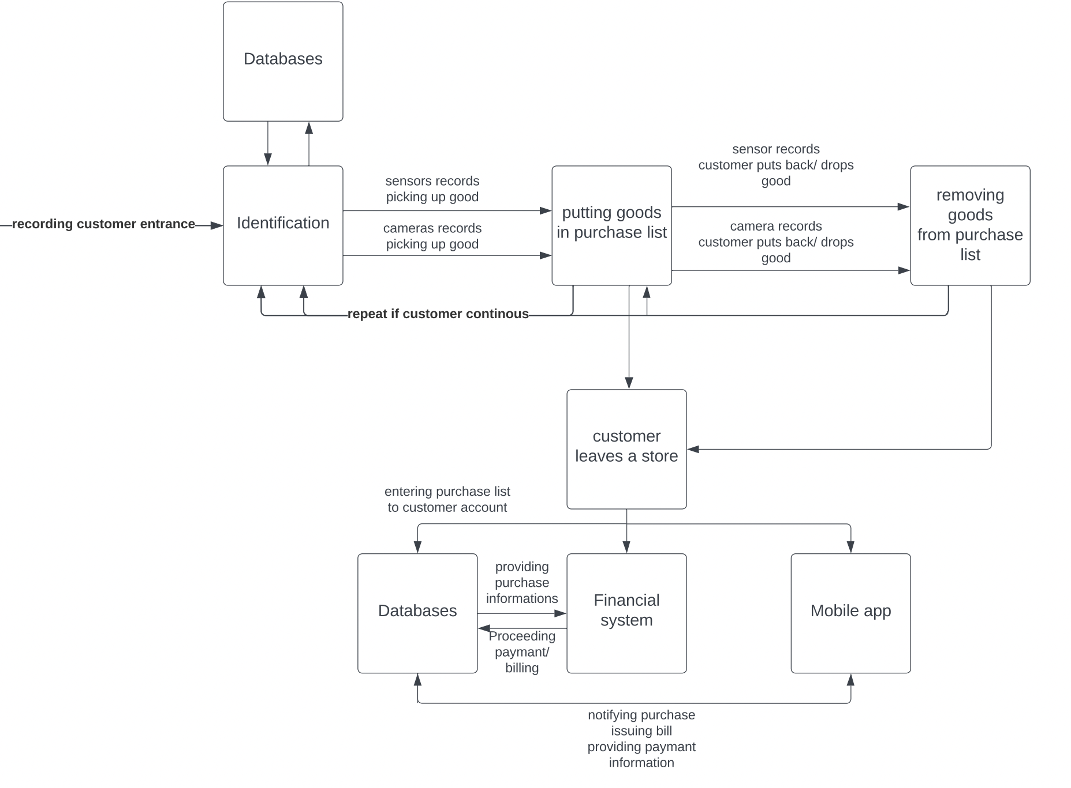
Software Architecture scheme
The diagram demonstrates basic software architecture of the project. First of all, customer has to create account and provide necessary information such as name, email address, phone number and data of bank credit or debit card. That will give customers access to grocery and its services.
The customer may replenish account with any bank debit or credit card. Moreover, it may deposit cash directly into his account, this will instantly update account balance.
The moment customer enters the shop and pick up item, software will place order which includes all the goods customer has in its basket. After customer leaves store, all items which have been sold will be delivered to transaction process where certain amount of money will be withdrawn from the account balance and transaction check will be placed in transaction history.
Broker may place a order, its data will be processed through Stock Exchange Center

Slide 14
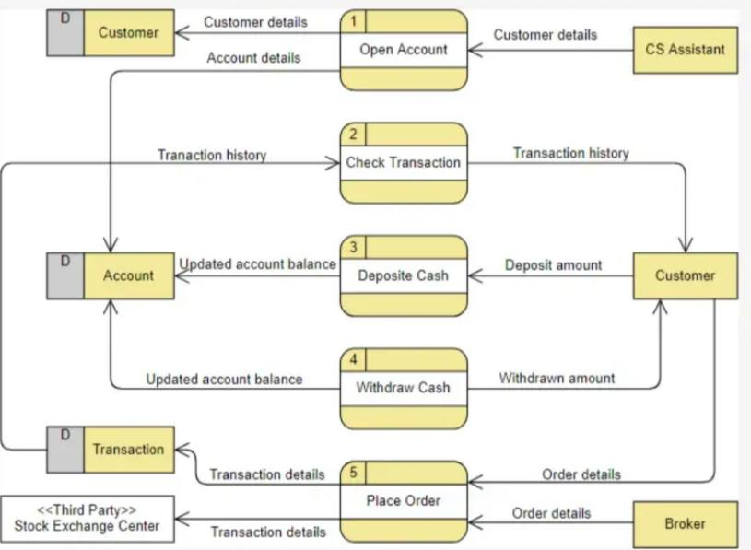
Data-Flow diagram

Slide 15


List of equipment and budget for equipment for each participant described above (only hardware). Budget (including all outlay)

Slide 16
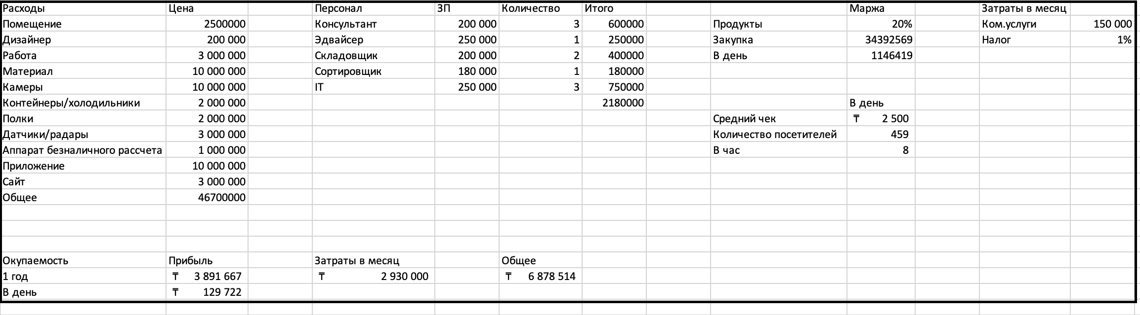
Costs per month:
- Commercial services - 150,000 tenge
- Tax - 1% / month.
Costs per month total - 1 580 000 tenge
Desired profit - 3 891 667 tenge
General - 5 517 264 tenge Average check - 2000 tenge
Number of people per day - 460 Number of people per hour - 8

Slide 17
Analysis:
Solvency of Almaty residents (average salary, how much they spend on food)
Divide into districts (will help you understand where to open)
Product prices
Total Market Size and Amazon Go Expansion Opportunity
Number of stores - 42 Number of positions - 5000 Payment - cash / card Premises:
1) 10 000 tenge m2 - 250 m2
Bostandyksky district, Medeusky district, Almaly district Renovation:
Designer - 200 000 tenge
2) Work - 3,000,000 tenge / 10,000 tenge per m2
3) Material - 10 000 000 TG Equipment:
Cameras – 5 000 000 tenge/100 cameras
Containers/refrigerators - 2,000,000 tenge 3) Shelves - 1,000,000 tenge
Sensors / radars - 3,000,000 tenge
Cashless settlement device - 1,000,000 tenge System:
Application - 10,000,000 tenge 2) Website - 3,000,000 tenge
Staff:
Consultant - 2*200 000
Loader - 200 000
Warehouse adviser - 250,000

Slide 18




